Slide 1

MONTHLY
PERFORMANCE REVIEW
[FINANCE]
September (August Data) 2012

Slide 2
Slide F
Training Status of Project Managers Assigned to Major Initiatives
Systems to Drive Performance
  OPP snapshot of PM training is correct

Slide 3
Commercial Small Business Payments
Note: OMB instructed Agencies to accelerate payments to small businesses with the goal of paying small businesses within 15 days of receipt of appropriate documentation. Delivery of goods and acceptance of services must still occur before making payment. VA has for many years used existing authority in the Prompt Payment Act to accelerate commercial vendor small business payments after receiving all proper documentation, including acceptance. Entities designated as small businesses are submitted for payment through FMS (not money managed) when acceptance occurs.
August Highlights:
VA paid 94 percent of small business invoices in July within the 15 day timeliness metric bettering the VA goal
  FSC issued a notice to VA stations highlighting the OMB goal and encouraged timely certification of invoices and receipt processing during VHA Fiscal Officers Calls
  FSC has an ongoing mail campaign to vendors to promote ways to shorten the payment cycle time and obtain payment information by using Electronic Funds Transfer (EFT), Electronic Invoicing, Central Contractor Registration (CCR), and FSC’s Vendor Inquiry System (VIS) web portal to monitor payment information
  FSC continues to analyze small business payment data to identify opportunities to further increase payment timeliness and will work with Administrations/Stations to identify causes for delayed payments and potential procedures for accelerating payments
Prepared by: Kevin Miers, Systems & Procedures Analyst, VA Financial Services Center, Kevin.Miers@va.gov
Approved by: Robert Adams, Deputy Director, VA Financial Services Center, (512) 460-5002
Version Date: September 11, 2012

Slide 4
Linkages
Org | OM
B/Line | Enabling
Metric Type | Performance
B/Scorecard | Operations
Strategic Goal | 4
Corp Outcome | Improve Management and Support Services Timeliness
Status
Current Month (August)
Next Month (September)
Projected Green Date | N/A
G
G
Metrics Detail:
Commercial Small Business Payment Timeliness
Timeliness Exceeds Goal
Percent Paid Within 15 Days of Receipt of All Proper Payment Documentation

Slide 5
Overall Commercial Vendor Payment Timeliness
Note: Overall Commercial Vendor Commercial Payment Timeliness measures VA vendor payment timeliness against the July 2012 OMB guidance to pay all commercial vendors within 15 days of receipt of all payment documentation. Delivery of goods and acceptance of services must still occur before making payment.
August Highlights:
In August, VA established a new Prompt Payment Type Code (“Y”) to facilitate acceleration of commercial vendor payments to pay at 14 days after receipt of all proper payment documentation
For August, VA paid 38 percent of all commercial vendors within the 15 day OMB goal
FSC began manually accelerating commercial vendor payments on August 3rd, paying 67 percent of August’s payments within the 15 day goal
Non-FSC entities paid 20 percent of all commercial vendors within the 15 day OMB goal
FSC is working with the Denver Acquisition and Logistics Center (DALC) to program the use of the new Prompt Payment Type “Y” code to pay vendors at the 14 day point into their prosthetics EDI payment process. That conversion is expected to enable VA to exceed the VA goal in September
Prepared by: Kevin Miers, Systems & Procedures Analyst, VA Financial Services Center, Kevin.Miers@va.gov
Approved by: Robert Adams, Deputy Director, VA Financial Services Center, (512) 460-5002
Version Date: September 11, 2012

Slide 6
Linkages
Org | OM
B/Line | Enabling
Metric Type | Performance
B/Scorecard | Operations
Strategic Goal | 4
Corp Outcome | Improve Management and Support Services Timeliness
Mini Drill-Down for
RED Status
Why off plan?
When back on plan?
What will it take to get back on plan?
Status
Current Month (August)
Next Month (September)
Projected Green Date | N/A
R
G
Metrics Detail:
Overall Commercial Vendor Payment Timeliness
Implementation During August
Percent Paid Within 15 Days of Receipt of All Proper Payment Documentation

Slide 7
PCS Change of Station – Pre-Move Notes
Pre-Move survey measure evaluates customer satisfaction with services for PCS move preparatory events, including:
  Initiation of PCS travel documents
  FSC counseling of employees
  Initiation of Household Goods (HHG) work order with Relocation Move Management
  Initiation of applicable home sale work order with Prudential Relocation
Employees are not required to respond to survey, but all employees completing pre-move events are surveyed
Survey asks customers to rank overall satisfaction with pre-move services
  Scale: 1 – Very Dissatisfied to 5 – Very Satisfied
  Goal is 4.4 FY 2012 3rd Quarter – 4.6
Survey Statistics FY 2011 FY 2012
              Q1 Q2 Q3 Q4 Q1 Q2 Q3 Q4
  Number Surveyed 298 248 286 278 194 184 232
  Number Responses Received 93 111 142 89 74 76 84
  Percentage of Responses Received 31% 45% 50% 32% 38% 41% 36%
  Summary of Results 4.5 4.6 4.6 4.5 4.5 4.8 4.6
  (Note: FSC uses a mid-point follow-up contact with survey recipients to try to increase survey response rates)
Types of employee survey responses with pre-move process concerns
  The Expense report instruction does not have a break down between "Lump Sum" and "Actual" in the “Enroute" section
    Lump sum option does not exist for the Enroute entitlement
  Understanding eligibility entitlements for return rights
    Return rights mimic a new hire’s entitlements. Employee felt transfer entitlements were allowed
  It would also be good to know a little better about what would be reimbursed when using the actual cost option
    Some inquiries are outside the norm briefed in the counseling session, before answering FSC PCS staff research the FTR and available travel decisions to ensure compliance and pay all that is authorized to each employee
  Clearer definitions of who is the initiator of each request requiring approval and how the employee will be kept informed
    The steps for document approval are included in the entitlement document on the final page of the counseling memo sent to each employee
  Counselors provided great explanation over the entitlements and process
Next Step: Continue to review survey data and identify improvement opportunities

Slide 8
Linkages
Org | OM
B/Line | Enabling
Metric Type | Performance
B/Scorecard | Client Satisfaction
Strategic Goal | 4
Corp Outcome | Increase Client Satisfaction (as a result of Increased Employee Satisfaction)
Status
Current Quarter (Q3)
Next Quarter (Q4)
Projected Green Date | N/A
G
G
Key Trend Line:
Permanent Change of Station (PCS) Client Satisfaction – Pre-Move
Client Satisfaction Exceeds Goal
OM’s Financial Services Center (FSC) uses customer surveys to measure employee satisfaction with PCS move services provided.
FSC tracks satisfaction with pre- move activities involving initial PCS steps such as processing of travel documents, employee move counseling, and initiation of household goods (HHG) and home sale work orders which are displayed here.
Scale of 1-5, With 5=Very Satisfied and 1=Very Dissatisfied
PCS Pre-Move Survey Response Recap
Qtr/Yr | # Surveyed | # Responded | %
Q1/2011 | 298 | 93 | 31%
Q2/2011 | 248 | 111 | 45%
Q3/2011 | 286 | 142 | 50%
Q4/2011 | 278 | 89 | 32%
Q1/2012 | 194 | 74 | 38%
Q2/2012 | 184 | 76 | 41%
Q3/2012 | 232 | 84 | 36%
Q4/2012

Slide 9
PCS Change of Station – Post-Move Notes
Post-Move survey measure evaluates customer satisfaction with PCS services for move events, including:
  Physical move to new station
  Household Goods (HHGs) shipment and delivery
  Home sale services initiation of PCS travel documents
  Travel claims processing
Employees are not required to respond to survey, but all employees completing post-move events are surveyed
Survey asks customers to rank overall satisfaction with post-move services
  Scale: 1 – Very Dissatisfied to 5 – Very Satisfied
  Goal is 4.0 – FY 2012 3rd Quarter – 4.1
Survey Statistics FY 2011 FY 2012
              Q1 Q2 Q3 Q4 Q1 Q2 Q3 Q4
  Number Surveyed 363 203 251 280 198 316 175
  Number Responses Received 89 59 89 62 40 103 66
  Percentage of Responses Received 25% 29% 35% 22% 20% 33% 38%
  Summary of Results 4.1 3.9 4.2 4.0 4.0 4.0 4.1
  (Note: FSC uses a mid-point follow-up contact with survey recipients to try to improve survey response rates)
Types of employee survey responses with post-move process concerns
  RMW representatives were courteous, caring and sympathetic to my moving needs
  Employee had concerns with the moving van line used for their move
    FSC provided survey feedback to RMW management and RMW COTR
  Brookfield (new Prudential corporate name) was hard to reach – had to leave messages on phone machine
    FSC participates in weekly calls to ensure any potential problems are addressed as soon as possible
    FSC provided survey feedback to Brookfield management and Brookfield COTR
  My HR representative acted as if they did not know what to do; as if they had never completed a PCS before
  The West Palm Beach office and Birmingham representatives were very helpful
    FSC participates in monthly HR calls and provides feedback
  Develop a handbook of some sort and provide to PCS’ing employees; FAQs, what to expect, the whole process etc.
    They are available and are provided to employees before and during the counseling session. All the same documents are on the PCS website
  The most difficult aspect of claims processing was trying to fax documents on legal sized paper
    Production of the claims automation was completed June 30, 2012. Roll out started with July 16th counseling sessions which eliminated faxing of documents
  Next Step: Continue to review survey data and identify improvement opportunities

Slide 10
Linkages
Org | OM
B/Line | Enabling
Metric Type | Performance
B/Scorecard | Client Satisfaction
Strategic Goal | 4
Corp Outcome | Increase Client Satisfaction (as a result of Increased Employee Satisfaction)
Status
Current Quarter (Q3)
Next Quarter (Q4)
Projected Green Date | N/A
G
G
Key Trend Line:
Permanent Change of Station (PCS) Client Satisfaction – Post-Move
Client Satisfaction Exceeds Goal
Scale of 1-5, With 5=Very Satisfied and 1=Very Dissatisfied
FSC also tracks satisfaction with post-move activities that include employee’s physical move, HHG shipment and delivery, travel claims processing, and home sale services.
PCS Post-Move Survey Response Recap
Qtr/Yr | # Surveyed | # Responded | %
Q1/2011 | 363 | 89 | 25%
Q2/2011 | 203 | 59 | 29%
Q3/2011 | 251 | 89 | 35%
Q4/2011 | 280 | 62 | 22%
Q1/2012 | 198 | 40 | 20%
Q2/2012 | 316 | 103 | 33%
Q3/2012 | 175 | 66 | 38%
Q4/2012

Slide 11
Linkages
Org | OM
B/Line | Enabling
Metric Type | Performance
B/Scorecard | Operations
Initiative | N/A
Strategic Goal | 4
Corp Outcome | Improve Management and Support Services Timeliness and Quality
Metrics Detail: Commercial Interest Penalties Summary
FYTD 2012 IPM Performance Betters FY 2012 goal
[Results Data in Green = Improvement From Previous Month]
*The monthly, FYTD, and annual goal for this measure is the same.
**No annual goal for total dollar value interest penalties.
SG4 - Data Through August 2012
Notes:
11
11

Slide 12
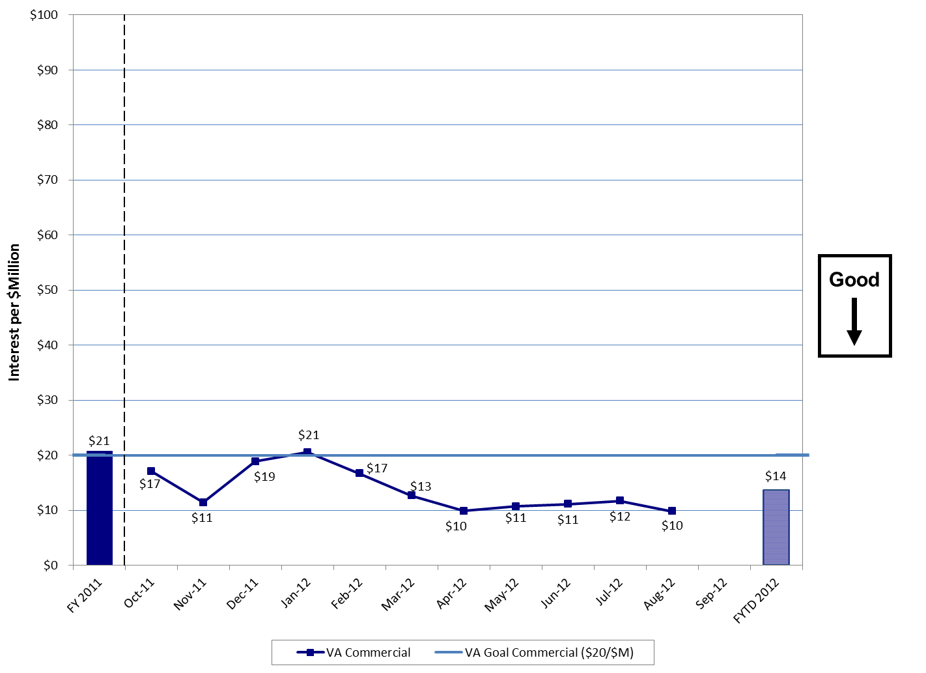
FY 2012 Interest per $Million
Commercial Payments
Bottom Line:
VA Commercial Payments Interest Per Million (IPM) decreased from $12 in July to $10 for August bettering the VA Goal. Also, FYTD 2012 performance represents a 37 percent improvement over the same period in FY 2011.
Notes:
12
12

Slide 13
Note: The FY 2012 interest per million dollars disbursed goal $20 for commercial payments subject to Prompt Pay Act (PPA) reflects a 5 percent improvement over the FY 2011 actual performance level.
August Highlights:
VA Commercial Interest Per Million (IPM) decreased from $12 in July to $10 for August. However, the FYTD 2012 IPM level of $14 is 37 percent better than the FYTD 2011 performance level ($21) for the same period
  IPM on FSC processed commercial payments decreased from $11 in July to $10 in August. However, FSC’s FYTD 2012 IPM level of $13 is 31 percent better than the FYTD 2011 performance level ($19)
  Supplemental Information:
VA’s overall IPM level decreased from $32 in July to $29 in August. Additionally, VA’s FYTD 2012 IPM level ($40) is 13 percent lower than the FYTD 2011 performance level ($46)
  IPM on Fee Basis payments decreased from $222 in July to $218 in August. Additionally, the July 2012 IPM level is 34 percent lower than the August 2011 performance level ($339)
    Seven stations paid $20.7K in Fee Basis interest penalties (64 percent of Fee Basis interest for August). The stations were: Harlingen,TX , 671 San Antonio, TX, Atlanta, GA, Cleveland, OH, Canandaigua, NY, Boise, ID, and Los Angeles, CA.
Last 12 Months:
Commercial Interest $196K
Commercial PPA Principal Amount $14.4B
Prepared by: Kevin Miers, Systems & Procedures Analyst, VA Financial Services Center, Kevin.Miers@va.gov
Approved by: Robert Adams, Deputy Director, VA Financial Services Center, (512) 460-5002
Version Date: September 11, 2012

